Slide 1

Streamlining Email Classification in
Crime Investigation Department
Team Leader:
Garima Chandna (102017070)
Members:
Rashmeet Kaur (102017065)
Simranjit Kaur (102017060)
Aakanksha Pandey (102017059)

Slide 2

Project Overview
Focused on streamlining the complaint classification process in CID.
Reduce the workload of investigators.
Categories -Accident, kidnap, murder, rape, theft.

Slide 3







Need Analysis
Manual Process
Time Consuming
Error Prone

Slide 4








Problem Statement and Objectives
DATA ACQUISITION
COMPLAINT CLASSIFICATION MODEL
WEBSITE

Slide 5
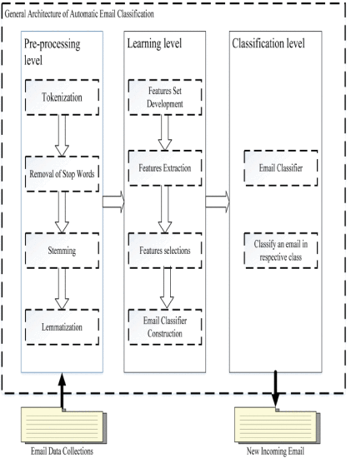
Model
Execution Plan

Slide 6
Project Outcomes
Complaint Email Classification Model- to classify complaint emails based on their content.
Website- A website will be developed that will integrate the complaint classification model.

Slide 7
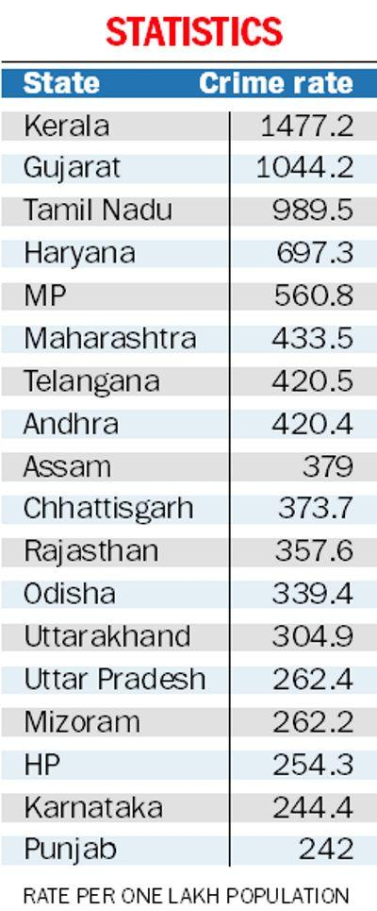
Crime rate: Haryana 4th on the list
Punjab stood 17th on the list, with annual crime rate per one lakh population.
Kerala tops the list.
Source: https://www.tribuneindia.com/news/punjab/crime-rate-punjab-17th-on-the-list-461056

Slide 8
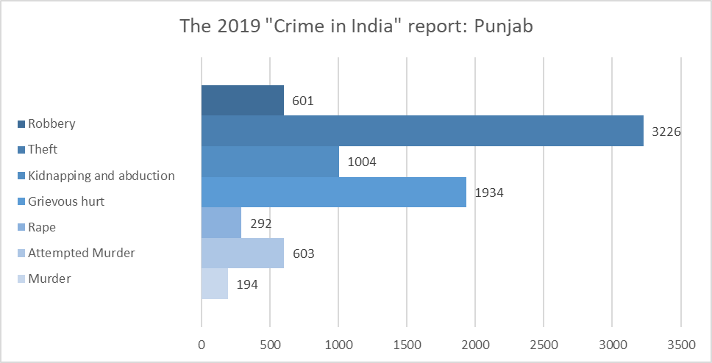
Ludhiana is the most unsafe city for minors

Slide 9
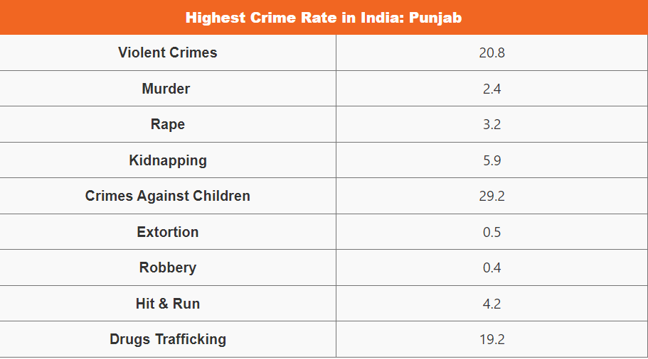
In Punjab, a total of 53,295 criminal cases were registered in 2019.
Out of the total criminal cases, 2,556 cases were related to minors.
second most affected cities for crimes against minors were - Sahibzada Ajit Singh Nagar (Mohali) and Patiala.
Other crimes- murder, attempted murder, causing grievous hurt, rape, theft, and robbery.
Source: https://www.adda247.com/pa/jobs/highest-crime-rate-in-india/
Notes:
According to the Punjab NCRB report, 2,556 cases were registered in Punjab. In which Ludhiana has been found to be the most unsafe city for minors. In which 283 cases are in Ludhiana only. Second are Sahibzada Ajit Singh Nagar (Mohali) and Patiala. Cases of infanticide have gone down from 11. However, incidents of child abduction and abduction have increased rapidly.
According to the 2019 “Crime in India” report released by the National Crime Records Bureau (NCRB), the crime rate in Punjab was 204.1 per 100,000 population.
The report shows that a total of 53,295 criminal cases were registered in Punjab in 2019, including 194 cases of murder, 603 cases of attempted murder, 1,934 cases of causing grievous hurt, 292 cases of rape, 1,004 cases of kidnapping and abduction, 3,226 cases. are cases of theft, and 601 cases of robbery.
Apart from these crimes, the report also shows that 10,336 cases of economic crimes, 228 cases of cyber crimes and 438 cases of crimes against women were reported in Punjab in 2019.

Slide 10
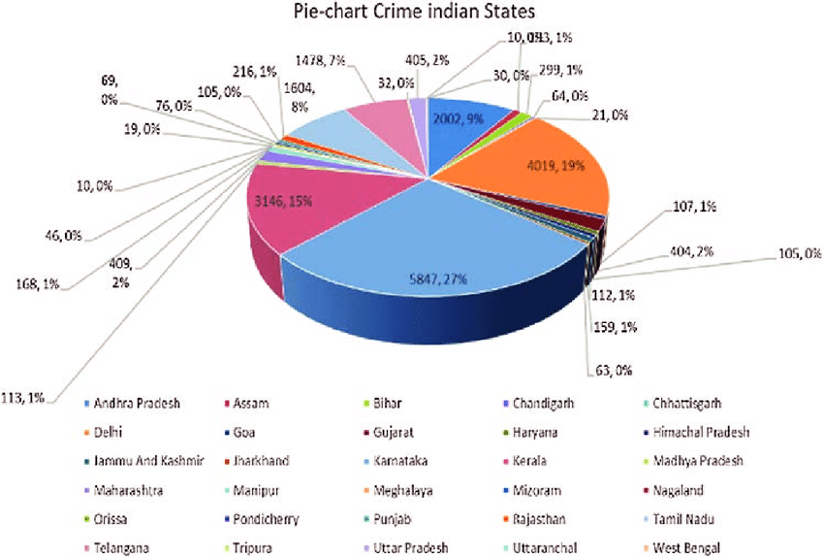
https://www.researchgate.net/figure/Crime-pie-chart-State-based-classification_fig7_339068025

Slide 11
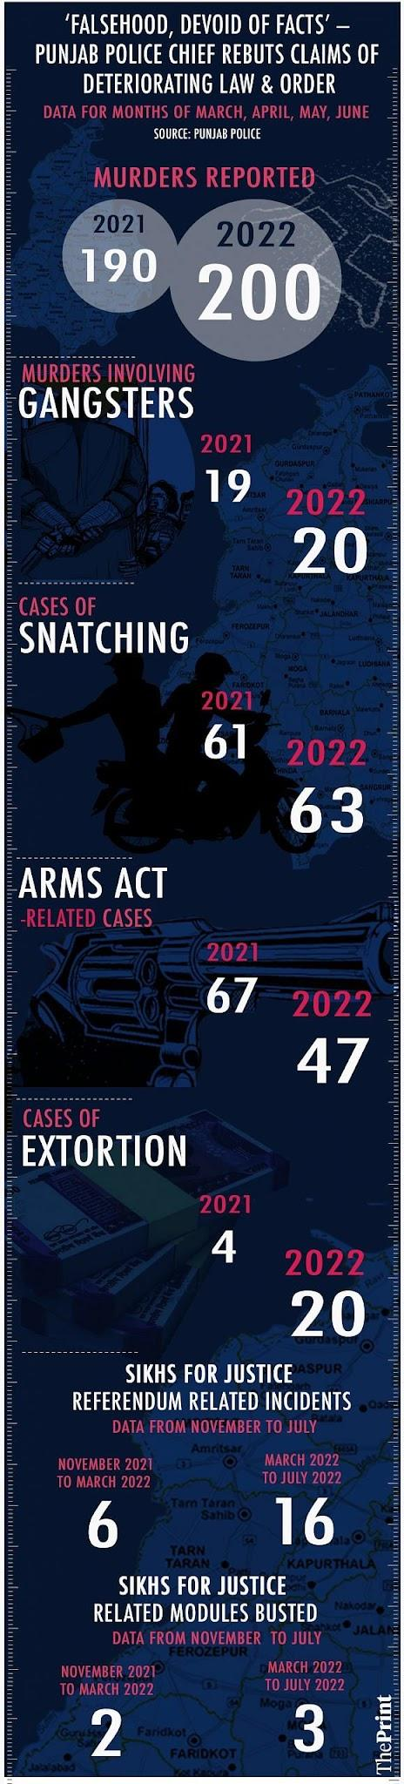
Source: https://theprint.in/india/falsehood-devoid-of-facts-punjab-police-chief-rebuts-claims-of-deteriorating-law-order/1052920/

Slide 12
Assumptions and Constraints
Assumptions:
The application requires a stable network connection.
The project assumes that there are no major data privacy concerns.
Constraints:
The accuracy of the classification system may be impacted by the diversity of email content and the changing nature of criminal activity.
The complaint email content will be written in Hindi language.

Slide 13
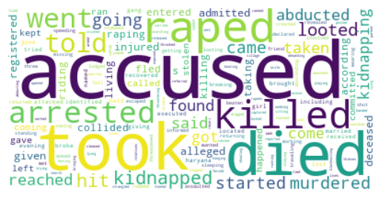
Brief about dataset
Number of categories - 5
Total training complaints - 442
Number of entries belonging to
each category in training dataset
Accidents - 81
Rape - 91
Theft - 90
Murder - 90
Kidnap - 90
Test data has 96 complaints.

Slide 14
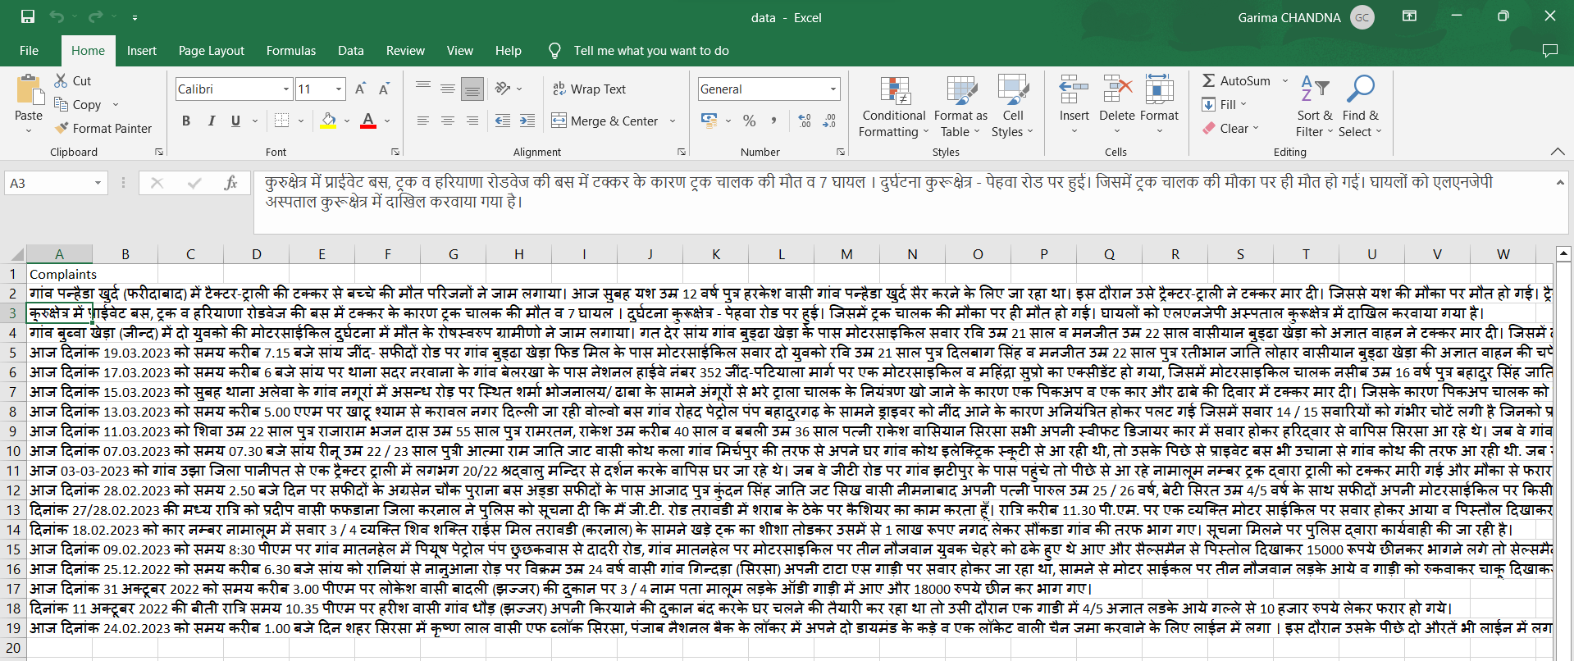
Data Translation
Data originally collected in Hindi Language.

Slide 15
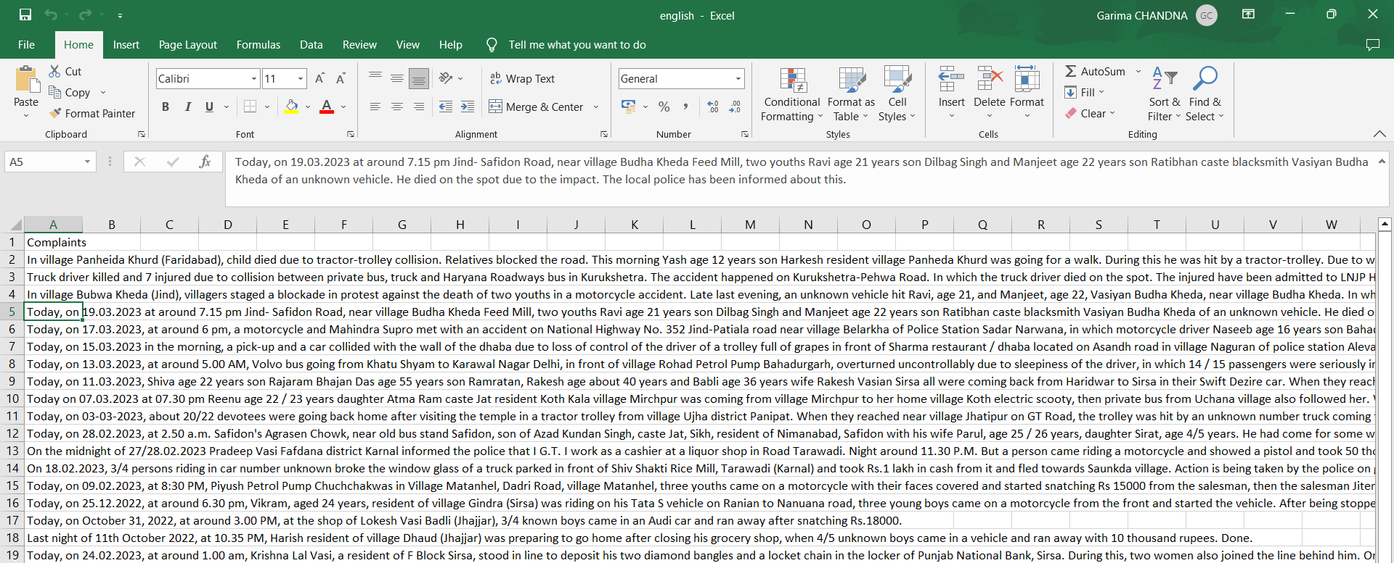
Data Translation (continued)
Data transformed to English Language for further processing.

Slide 16
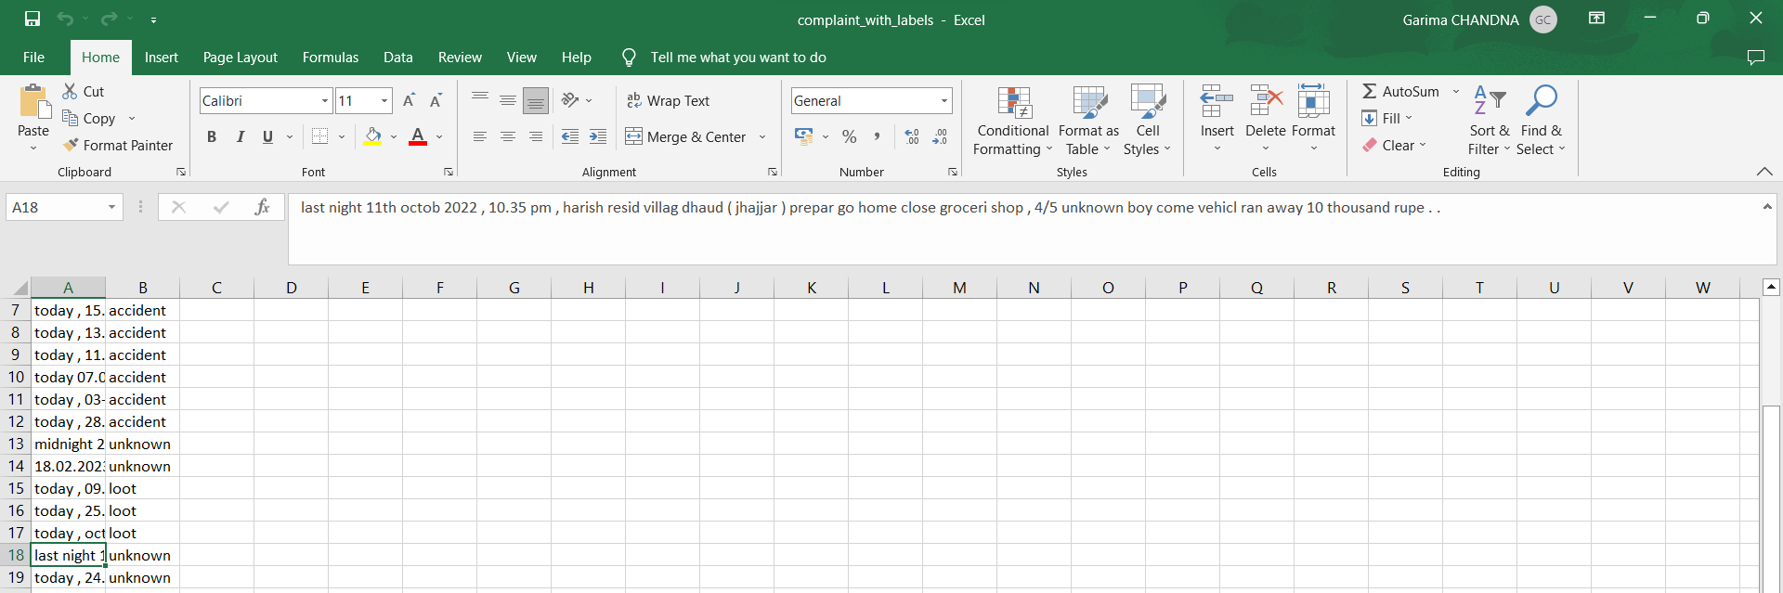
Labelled Data

Slide 17
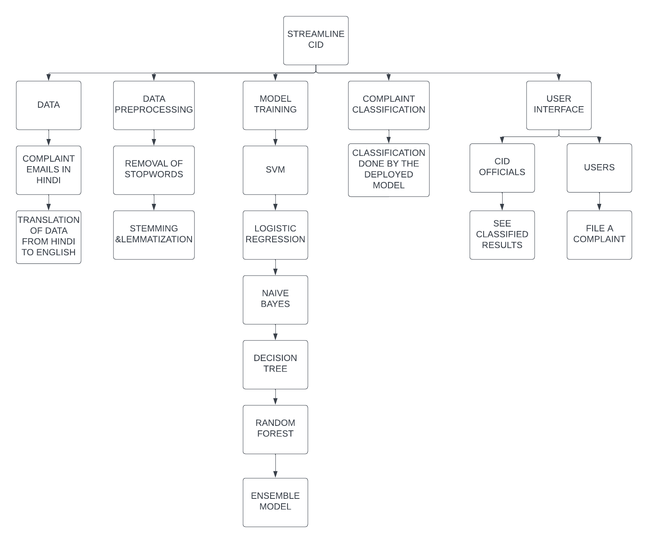
WORK BREAKDOWN STRUCTURE

Slide 18
MODELS AND ACCURACY
MODEL | VALIDATION | TEST
SVM | 0.93 | 0.83
NAIVE BAYES | 0.91 | 0.75
DECISION TREE | 0.8 | 0.62
LOGISTIC REGRESSION | 0.93 | 0.80
RANDOM FOREST | 0.85 | 0.71
ENSEMBLE MODEL (Logistic+Decision Tree + Naive Bayes + SVM) | 0.93 | 0.82

Slide 19

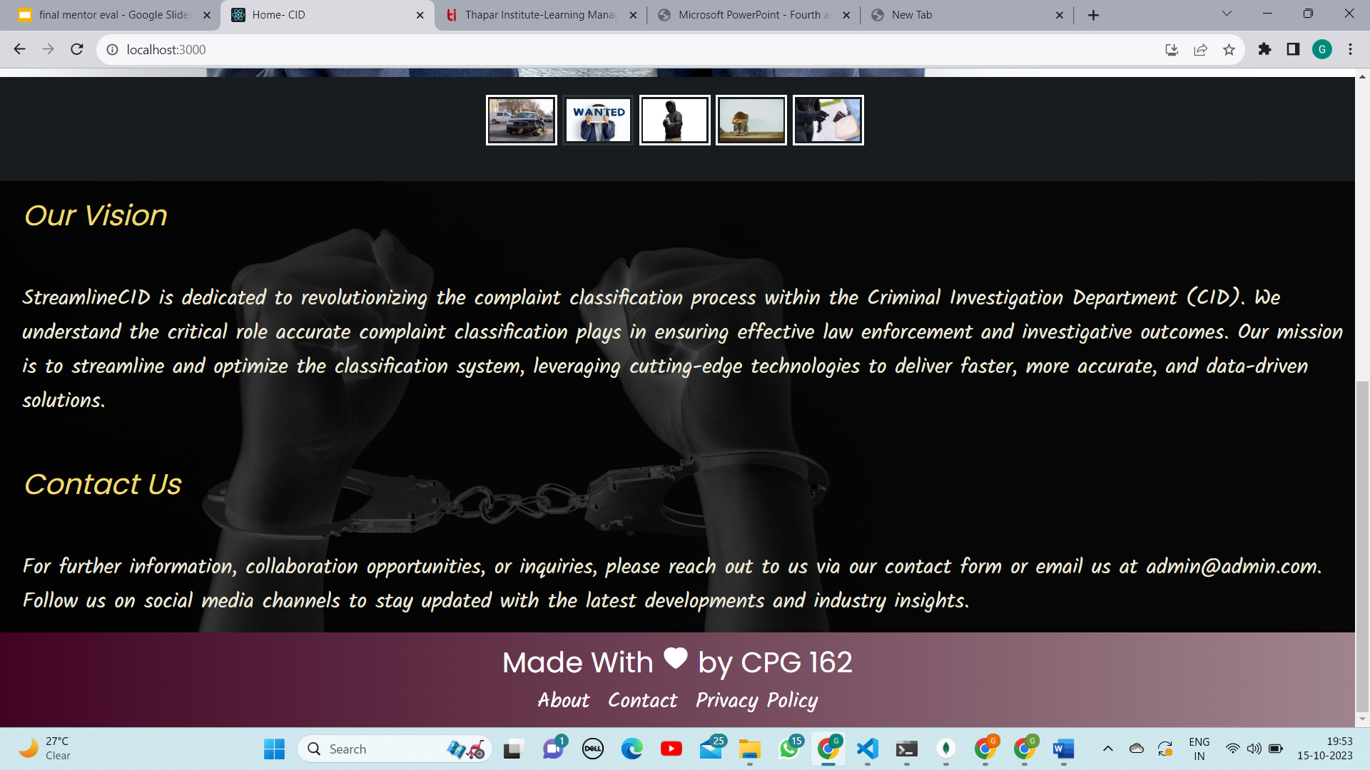
WEBSITE
HOME PAGE

Slide 20
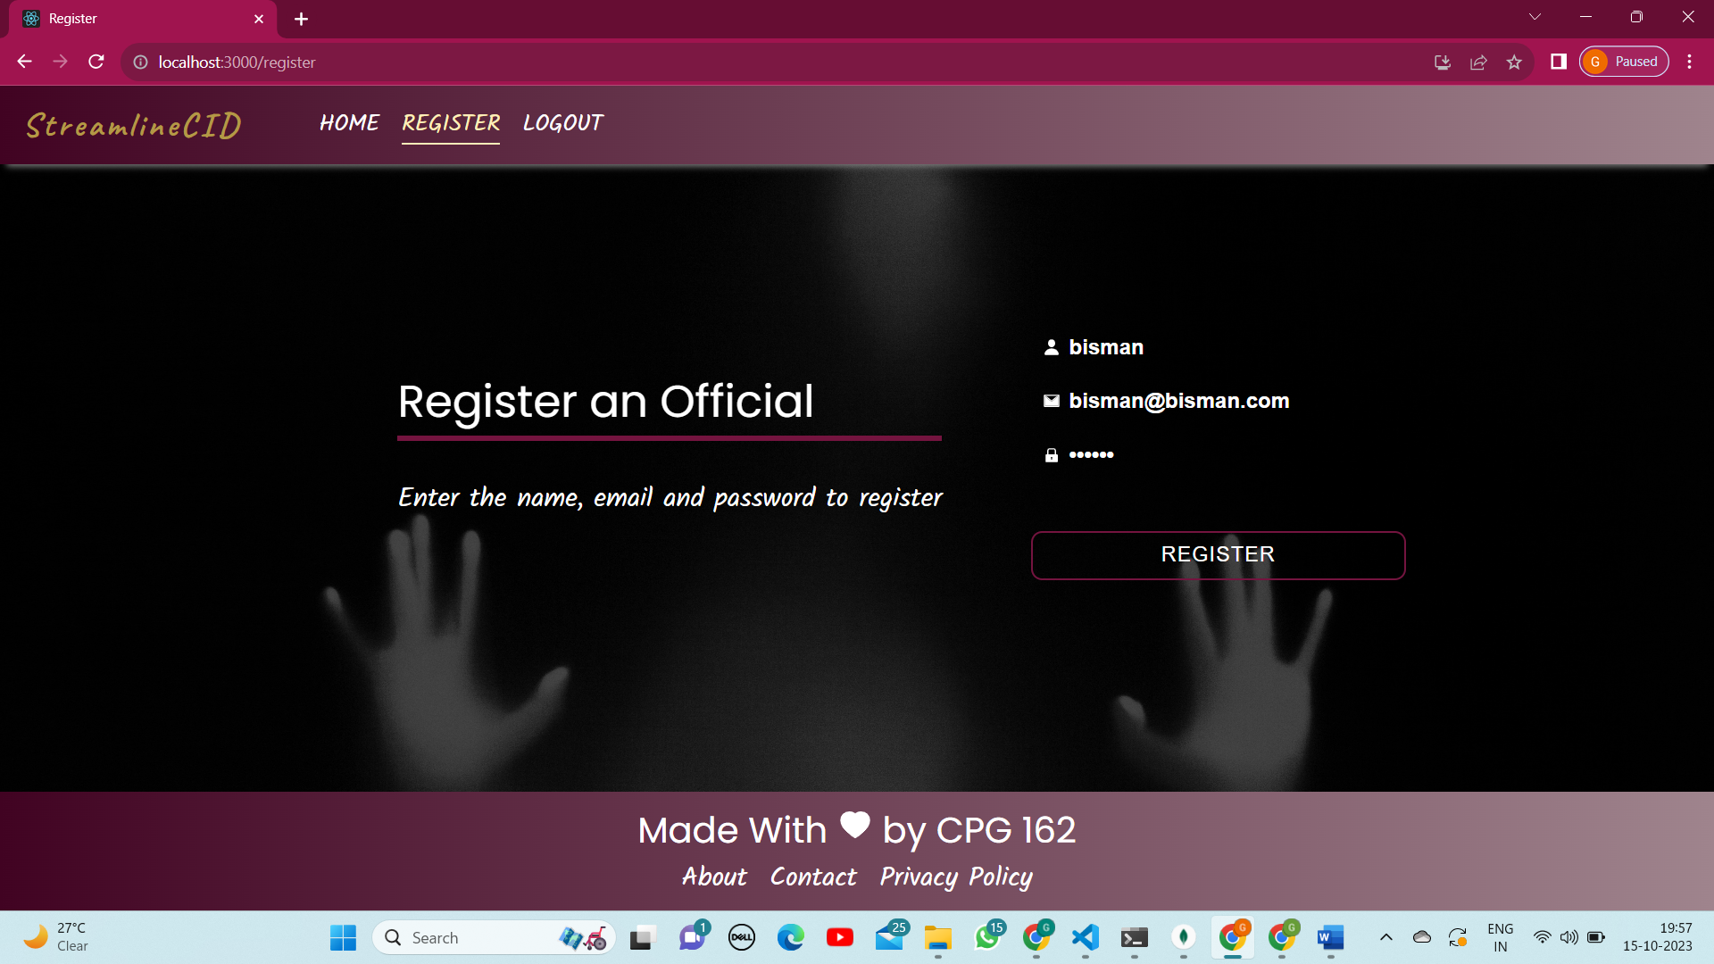

Slide 21
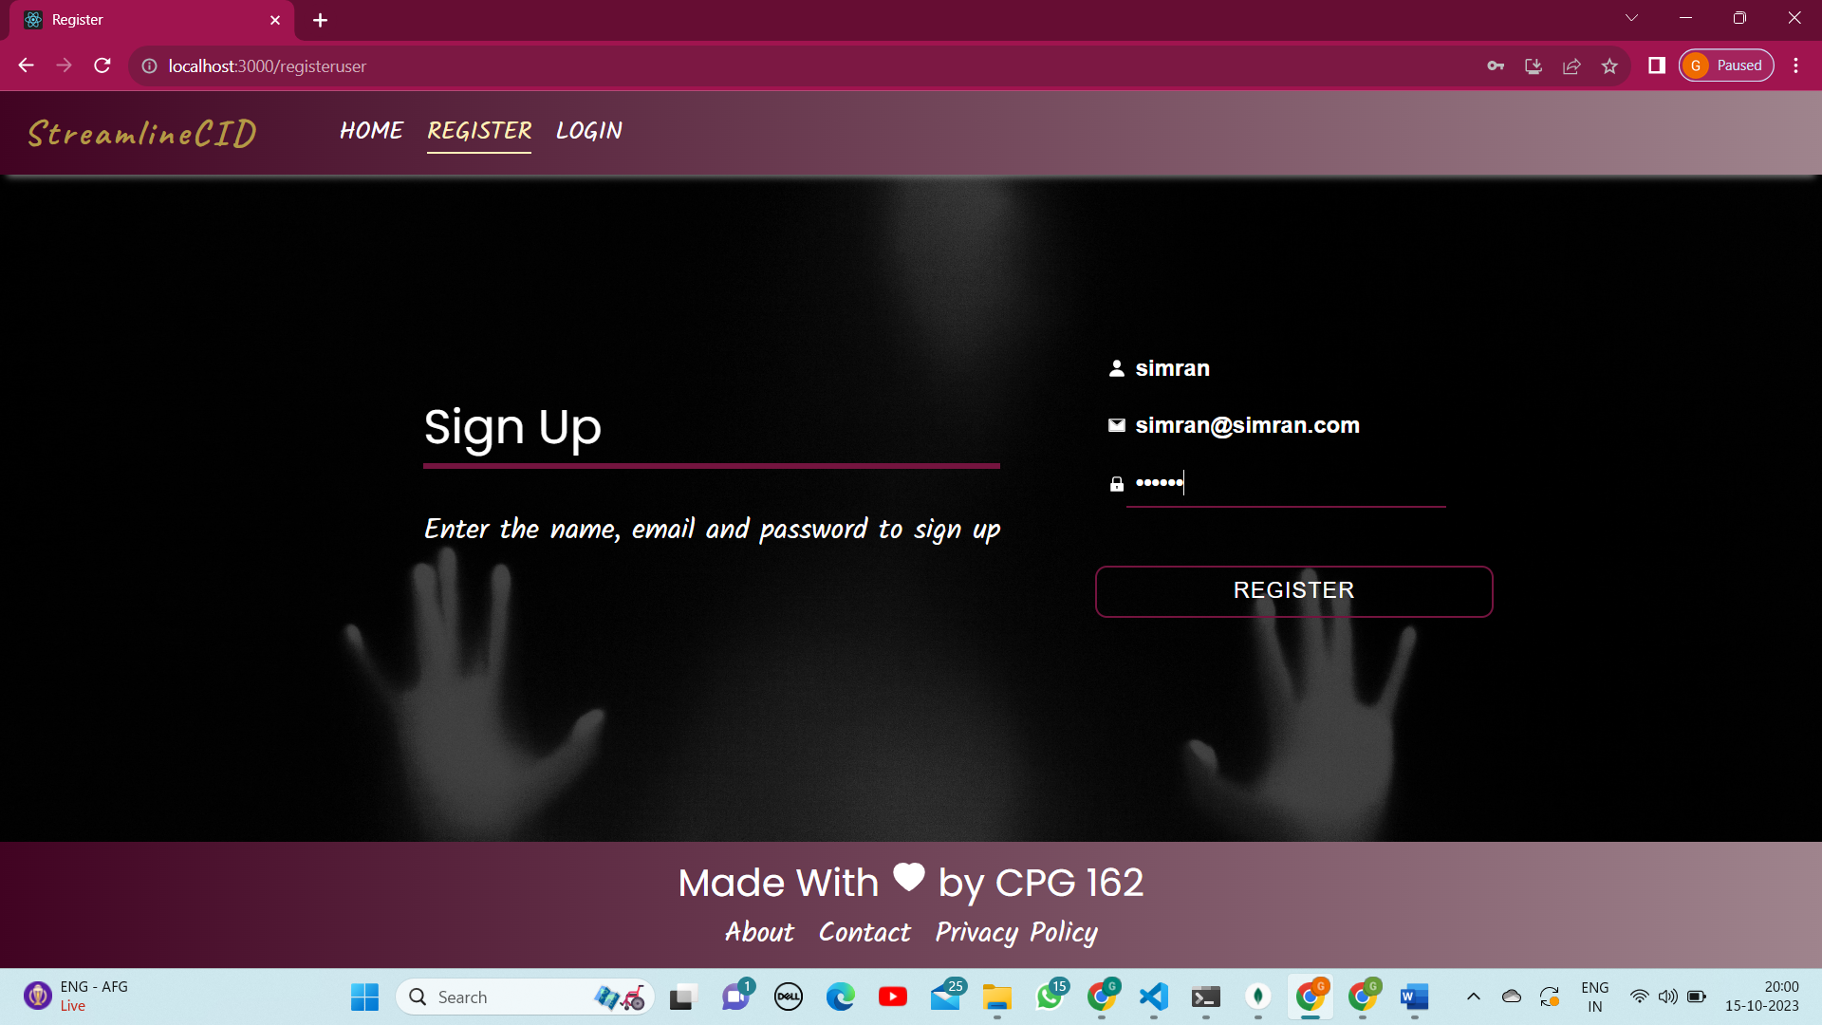

Slide 22
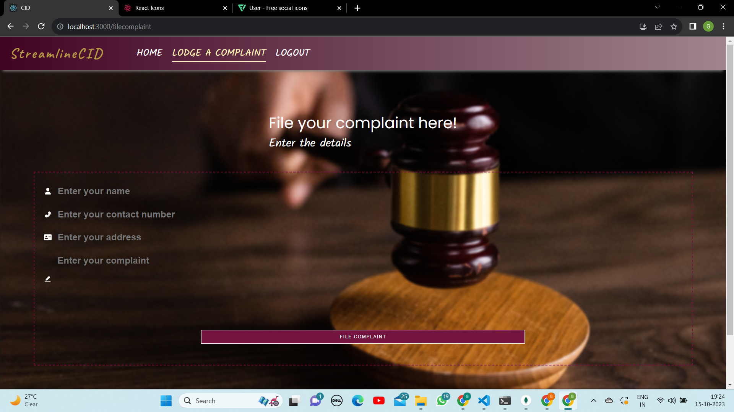

Slide 23
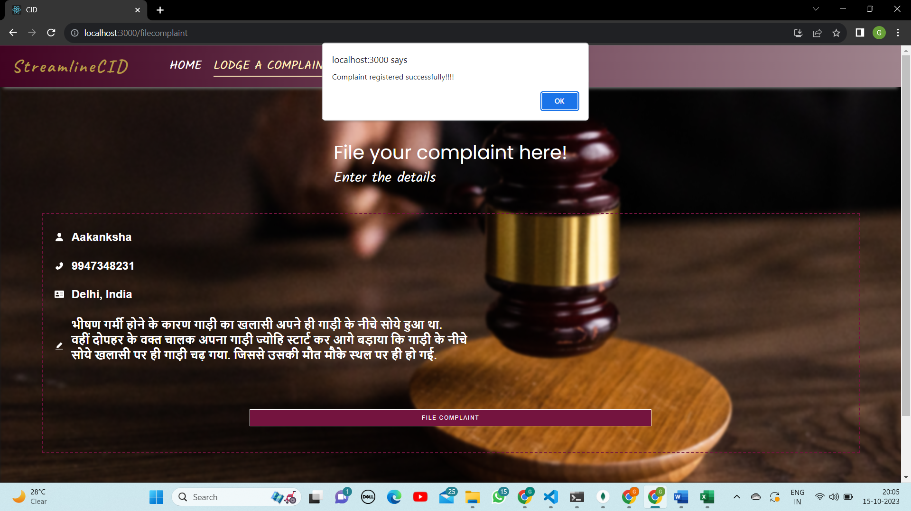

Slide 24
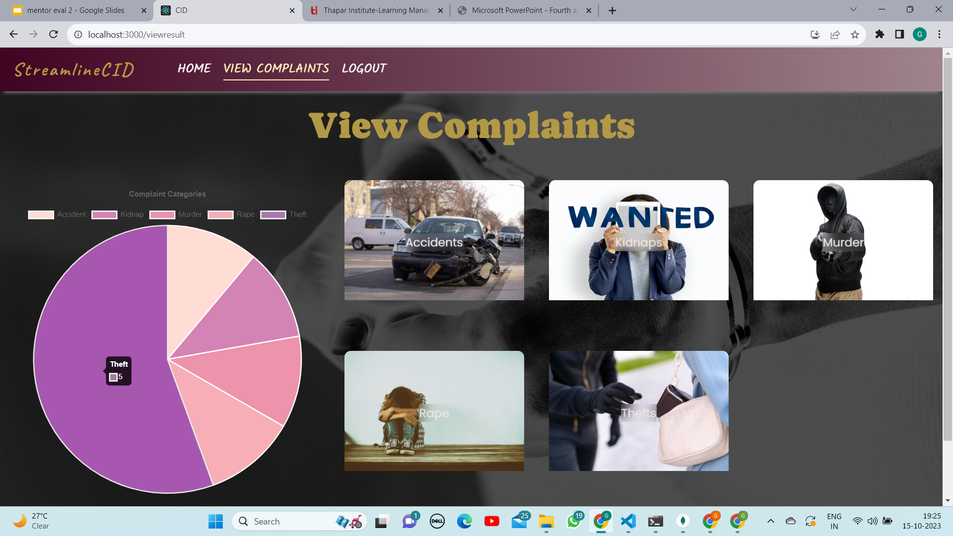

Slide 25
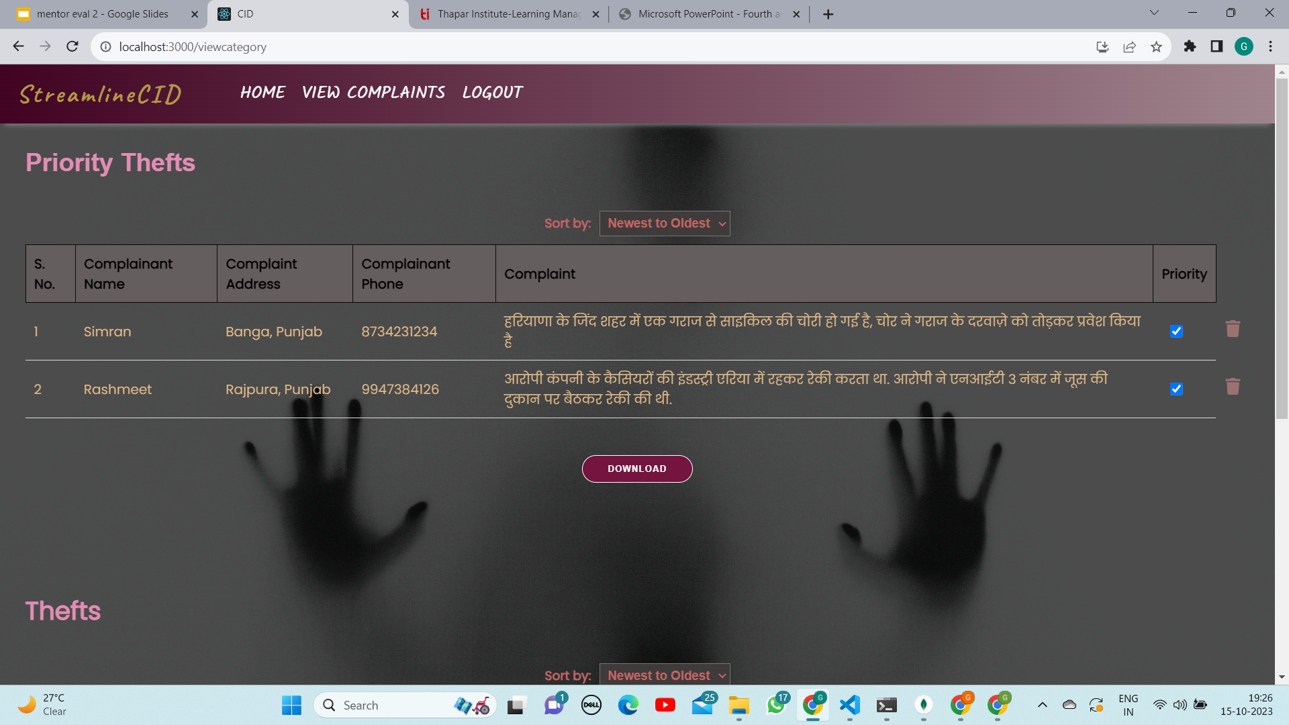
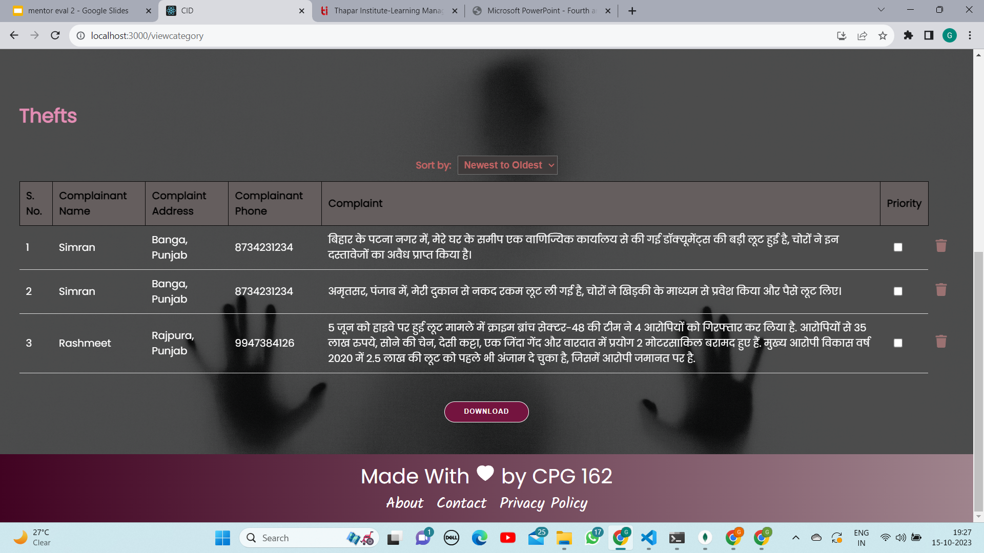
CATEGORIES
THEFTS

Slide 26
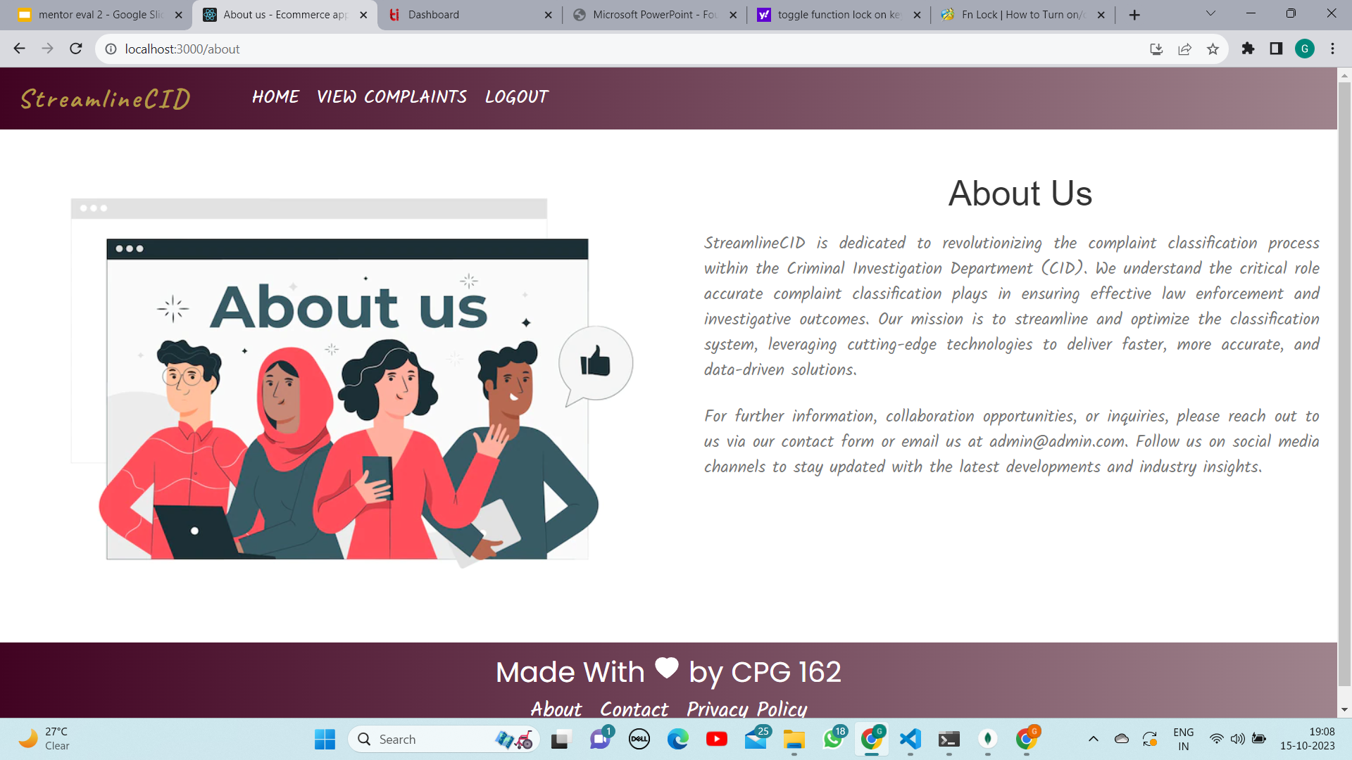

Slide 27


Slide 28
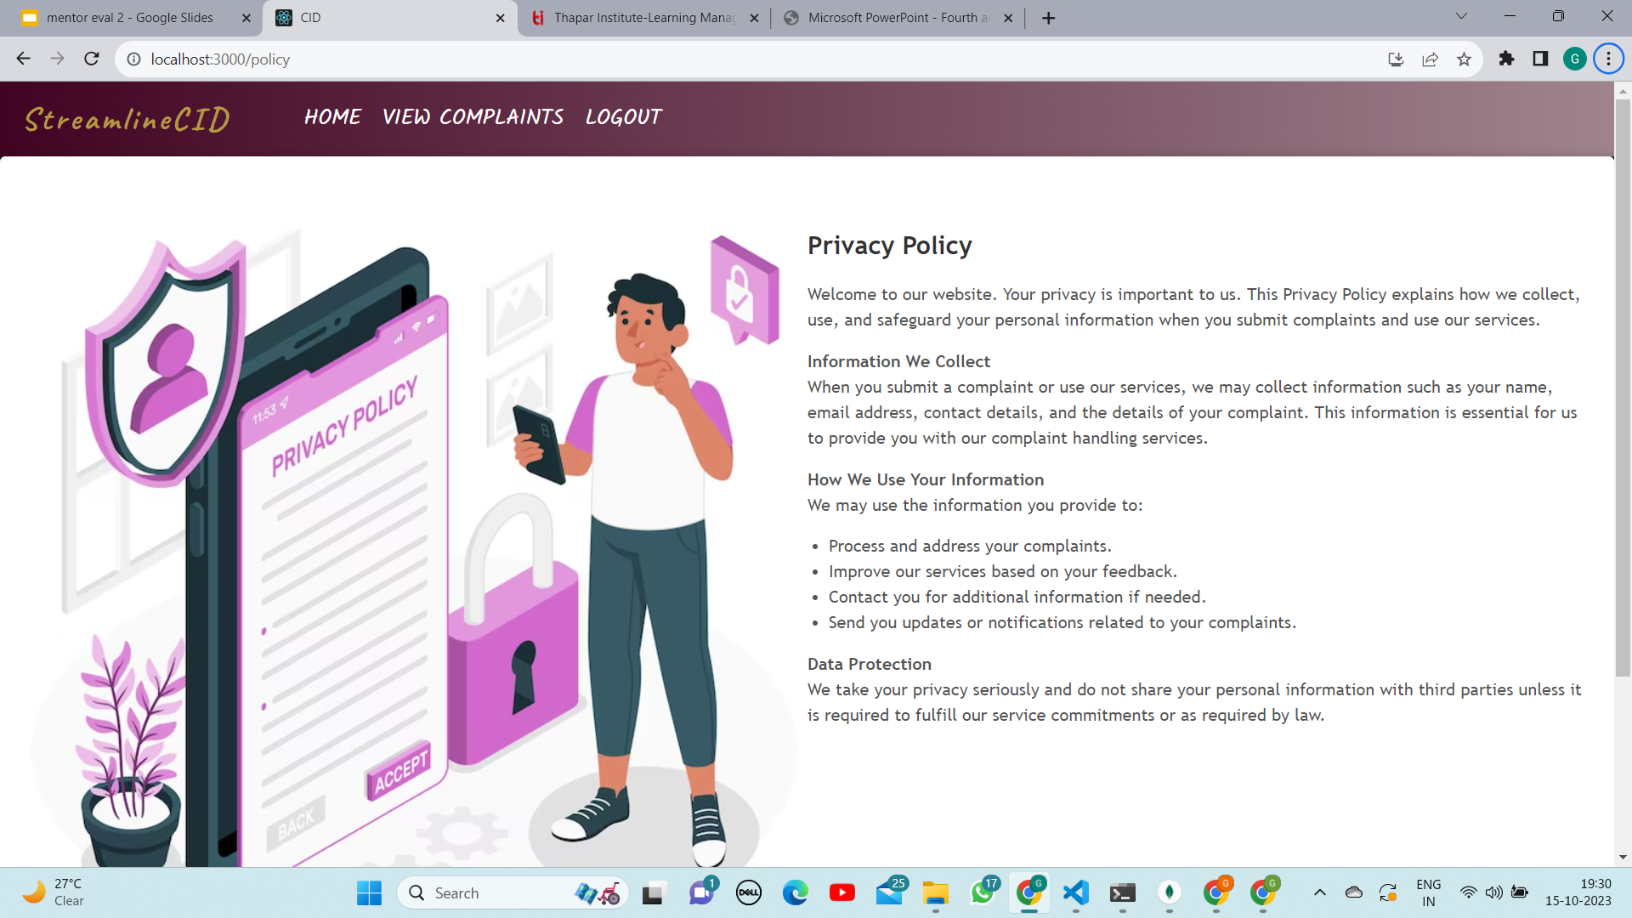

Slide 29

Literature Survey
Ref | Model | .Author(s) | Novelty | Feature Extraction | Details | Validation Measure | Limitation
[1] | Logistic Regression | A. Genkin | Logistic regression analysis of high-dimensional data | TF-IDF | It is based on Gaussian Priors and Ridge Logistic Regression | F1-Macro | Prediction outcomes is based on a set of independent variables
[2] | Naïve Bayes | Kim, S.B. | Multivariate poisson model for text Classification | Weights words | Per-document term frequency normalization to estimate the Poisson parameter | F1-Macro | This method makes a strong assumption about the shape of the data distribution
[3] | SVM and KNN | K. Chen. | Introduced TFIGM (term frequency & inverse gravity moment) | TF-IDF and TFIGM | Incorporates a statistical model to precisely measure the class distinguishing power of a term | F1-Macro | Fails to capture polysemy and also still semantic and sentatics is not solved
[1] Genkin, Alexander, David D. Lewis, and David Madigan. "Large-scale Bayesian logistic regression for text categorization." technometrics 49.3 (2007): 291-304.
[2] Kim, Sang-Bum, et al. "Some effective techniques for naive bayes text classification." IEEE transactions on knowledge and data engineering 18.11 (2006): 1457-1466.
[3] Chen, Kewen, et al. "Turning from TF-IDF to TF-IGM for term weighting in text classification." Expert Systems with Applications 66 (2016): 245-260.

Slide 30


Literature Survey
[4] | Conditional Random Field (CRF) | T. Chen et al. | Apply a neural network based sequence model to classify opinionated sentences into three types according to the number of targets appearing in a sentence | Word embedding | Improve sentence-level sentiment analysis via sentence type classification | Accuracy | High computational complexity and this algorithm does not perform with unseen words
[5] | Deep Learning | Z. Yang et al. | It has a hierarchical structure | Word embedding | Two levels of attention mechanisms applied at the word and sentence-level | Accuracy | Works only for document-level
[4] Chen, Tao, et al. "Improving sentiment analysis via sentence type classification using BiLSTM-CRF and CNN." Expert Systems with Applications 72 (2017): 221-230.
[5] Yang, Zichao, et al. "Hierarchical attention networks for document classification." Proceedings of the 2016 conference of the North American chapter of the association for computational linguistics: human language technologies. 2016.

Slide 31


